Slide 1
Introduction to Haitai Digital Energy

Slide 2
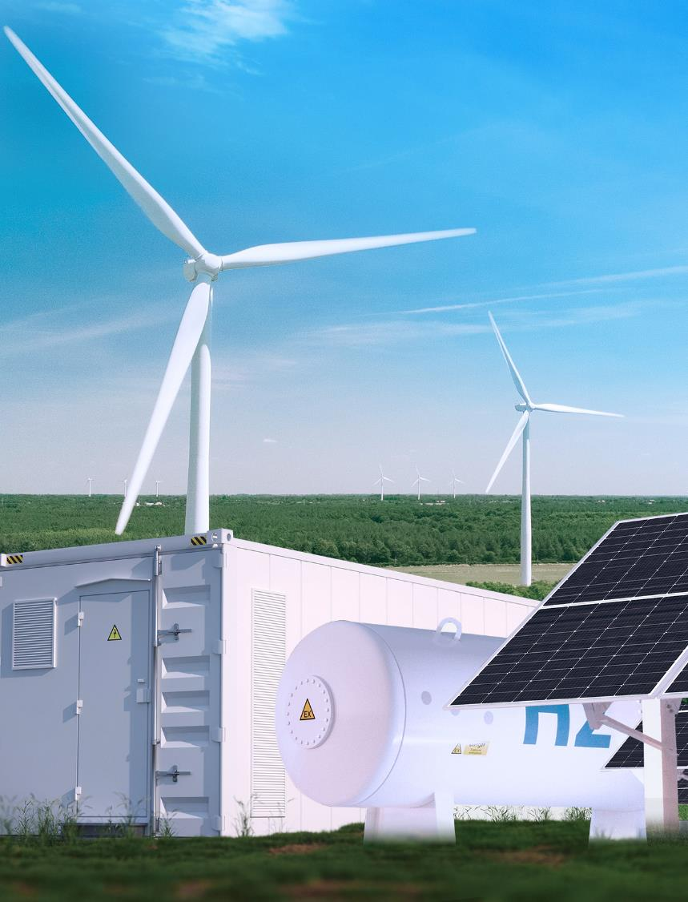
CONTENTS
01
Company Profile
02
Core Products

Slide 3
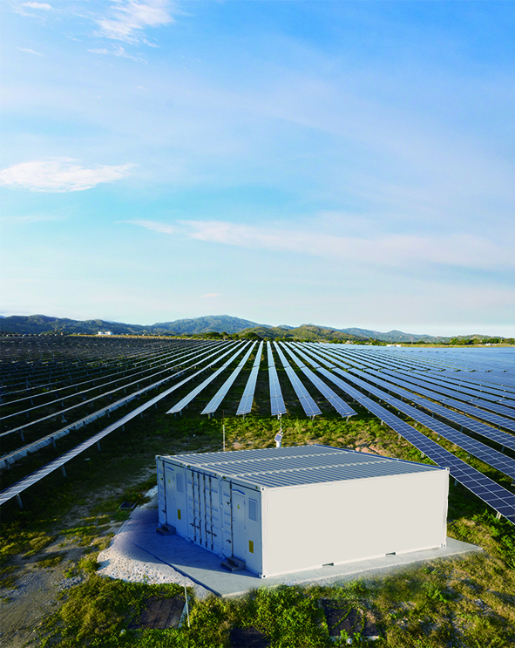
01
Company Profile

Slide 4
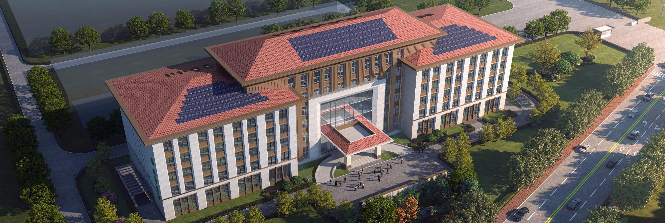
1.1 Group Overview
2006
Haitai Solar was founded in 2006
7
7 business sectors
100+
States/regions covered by business
500
Global top 500 new-energy enterprise
2000+
Total employees all over the world
18
Founded in 2006, Haitai Solar has run business of 7 sectors, i.e. PV modules, PV power stations, PV mounts, energy storage, hydrogen energy, wind energy and PV cells. First engaged in the manufacturing of solar PV modules, Haitai Solar was successful listed in Beijing Stock Exchange on August 8, 2022, realizing leapfrog development. The Company has also made certain progress in other new energy fields such as PV power station, PV mount and energy storage. In particular, the Company has integrated R&D, production of PV mount and energy storage.
Under the background of energy structure reform and "Carbon Peaking and Carbon Neutrality" goals, the Company will continuously create values with high quality products and supply efficient products based on technological innovation. This approach aims to provide global customers with efficient, eco-friendly green energy products, contributing to the supply of low-carbon, clean green energy for society.
With a history of over 10 years
Haitai Solar (835985.BJ)
is a China-based
comprehensive new-energy enterprise with overseas market layout

Slide 5
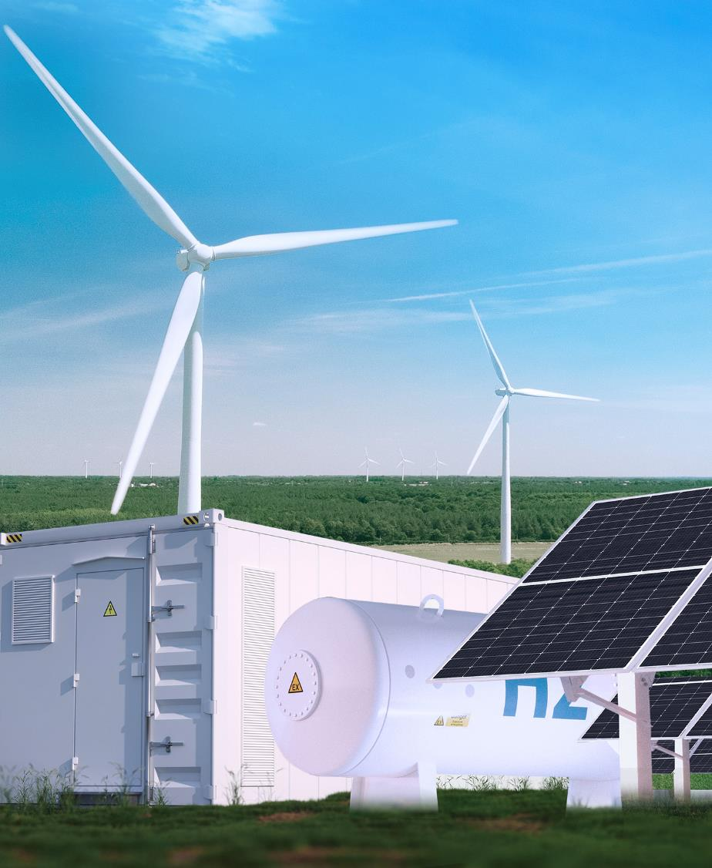
PV modules
PV power station
Tangshan Haitai Solar Technology Co., Ltd.
Founded in 2006, listed in Beijing Stock Exchange in 2022
Tangshan Haitai Electric Power Engineering Co., Ltd.
Founded in 2017
PV mount
Energy storage
Tangshan Haitai Intelligent Equipment Co., Ltd.
Founded in 2021
Tangshan Haitai Digital Energy Technology Co., Ltd.
Founded in 2021
Hydrogen energy
Wind energy
Tangshan Haitai Hydrogen Energy Technology Co., Ltd.
Founded in 2021
Tangshan Haitai Wind Energy Technology Co., Ltd.
Founded in 2022
PV cells
Battery swapping
Haitai Solar (Tianchang) Technology Co., Ltd.
Founded in 2023
Shenzhen Haitai Battery Swapping Co., Ltd.
Founded in 2023

Slide 6
1.2 Milestones
2006
2008
2011
2013
2016
Haitai Solar was founded
● Mature R&D strength and technology
● Entered PV industry completely
● The first 125MW component production line put in use
● Established "Haitai Solar Energy Battery R&D Center" along with Institute of Electrical Engineering, Chinese Academy of Sciences
● Included in the admission list of PV manufacturing of MIIT
● Passed the acceptance by Hebei Engineering Laboratory
● Established cooperation with SHARP and BYD, to explore Japan market completely
● Established its production base in Vietnam
● Acquired the "Pacemaker" power attenuation certificate for the first year
2023
2022
2021
2020
2017
● Provincial reliability laboratory put into use
● The third-party demonstration base was founded
● Listed in Beijing Stock Exchange
● Entered the field of wind energy
● Entered the field of TOPCon component formally
● The 6th batch of green supply chain
● Entered the field of PV mount, energy storage and hydrogen energy
● Established base in Shuozhou, with total output up to 8GW
● Manufacturing Industry Single Champion Enterprise in Hebei Province
● Tier 1 component manufacturer
● Total output reached 7GW
● Entered the field of PV power station
● Total output reached 2GW

Slide 7
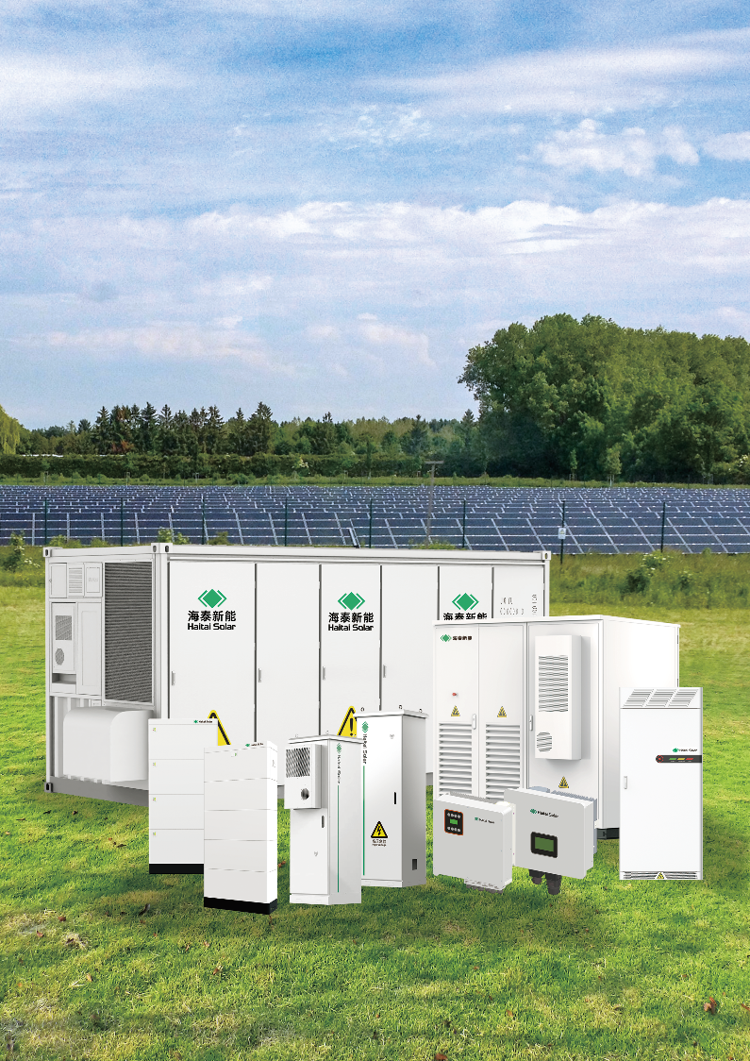
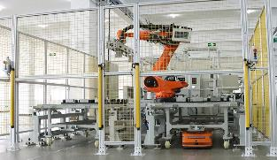
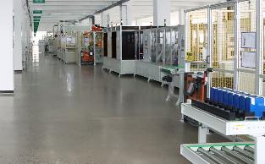
1.3 Overview of Digital Energy
The Company's energy storage business sector was founded in 2021. It is the supplier of global energy storage integrated products and system solutions of the Company. Full-auto, intelligent and efficient lithium battery module and PACK production line with single-line output up to 2GWh.
Haitai Digital Energy's products include
Large container energy storage system (1-10MWh)
Industrial and commercial energy storage system (215kWh, 233kWh, 256kWh, 372kWh)
Household energy storage system (single-phase 3-6kW, 3-phase 8-15kW, 5-30kWh)
Long lifespan, high safety, high efficiency/intelligence and digitalization/multi-level protection of software and hardware/modular design, facilitating capacity expansion, installation, operation and maintenance.
Product Advantages
Full-auto production equipment such as full-auto KUKA robot, high-accuracy OCV/IR and EOL test device, advanced plasma cleaner, lossless laser welding machine, full-auto production line, intelligent AGV robot, high-feedback charging/discharging test device; strictly control 256 quality control points, such as insulation, differential pressure, gluing welding detection, box airtightness test and capacity test of cell, module and PACK, in order to guarantee the product quality.
Production Advantages
Provide one-to-one, customized and professional system solutions, O&M management plans for customers, including on-grid and off-grid micro-grid, user end, grid end and power supply end.
Service Advantages

Slide 8
02
Core Products

Slide 9
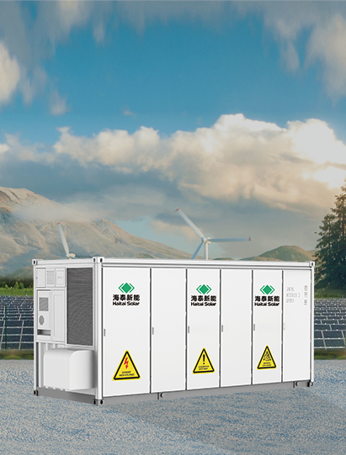
Haitai - Haidun
Container type energy storage system
Multi-dimensional and multi-layer battery protection strategies and fault isolation measures ensure the safety and stability of energy storage system
Simple and convenient O&M and small workload Low maintenance cost
Equipment such as firefighting equipment, thermal management system,door access, monitoring and liquid leakage protection equipment are introduced to ensure the safe and stable running of battery integration system.
Large battery capacity High conversion efficiency of energy storage system Comprehensive efficiency>85%
High-quality LFP batteries with a long cycle life > 6,000 cycles
Pre-installed container energy storage system can apply to various scenarios quickly Lower installation costs
Intelligent BMS system 3-level monitoring for energy storage system Ensure high efficiency and safety
Modular structure design Form various voltage platforms flexibly Various capacity grade systems

Slide 10
Technical Parameters of Energy Storage System
Liquid-cooled energy storage system
Model | HTDESS 1725/3420-LC
Cell capacity | 3421kWh
Cell Specifications | 3.2V/300Ah (0.5P)
Pack specification | 1P44S
Rated voltage | 1267.2V
Voltage range | 1108.8~1425.6V
Rated current | 1350A
Voltage accuracy (FSR) | 1%
Current accuracy (FSR) | 1%
Temperature accuracy | 2℃
SOC accuracy | 5%

Slide 11
Technical Parameters of Energy Storage System
Liquid-cooled energy storage system
Model | HTDESS 1725/3420-LC
AC system
Rated power | 1725kW
Output voltage | 690V
Voltage range | 690V±15%
Rated current | 1443A
Power factor | > 0.99 (rated power)
Rated frequency | 50Hz
Frequency | 45 ~ 55 Hz
THD | Below 3%
Transformer Parameters
Rated power | 1725kW
Voltage transformation ratio | 0.69kV / 35 kV
Transformer model | Dry transformer/oil transformer

Slide 12
Technical Parameters of Energy Storage System
Liquid-cooled energy storage system
Model | HTDESS 1725/3420-LC
AC system
Rated power | 1725kW
Output voltage | 690V
Voltage range | 690V±15%
Rated current | 1443A
Power factor | > 0.99 (rated power)
Rated frequency | 50Hz
Frequency | -5 ~ 5 Hz
THD | Below 3%
Transformer Parameters
Rated power | 2000kVA
Voltage transformation ratio | 0.69kV /10~ 35 kV
Transformer model | Dry transformer/oil transformer

Slide 13
3.1 Technical Parameters of Energy Storage System
Liquid-cooled energy storage system
Model | HTDESS 1725/3420-LC
Other Parameters
Cell container dimensions (mm) | 6058×2438×2896
Gross weight(t) | <36
Converter container dimensions (mm) | 6058×2438×2896 mm
Cell cooling mode | Intelligent liquid cooling
Converter cooling mode: Temperature control and forced air cooling | Temperature control and forced air cooling
Firefighting | Gas firefighting, combustible gas detection + exhaust air, water firefighting (optional)
Cycle life | >6000 times (@25℃, EOL80%)
Protection grade | Whole equipment: IP54; key equipment: IP65
Allowed temperature range | -25~+50℃
Allowed humidity range | 0 to 95% non-condensing
Max. altitude of running | ≤ 4,000*m
Note: *The equipment should enter derating operation at altitude above 2,000m
For changes in product dimensions and parameters, please refer to the latest materials; no further notice will be given

Slide 14
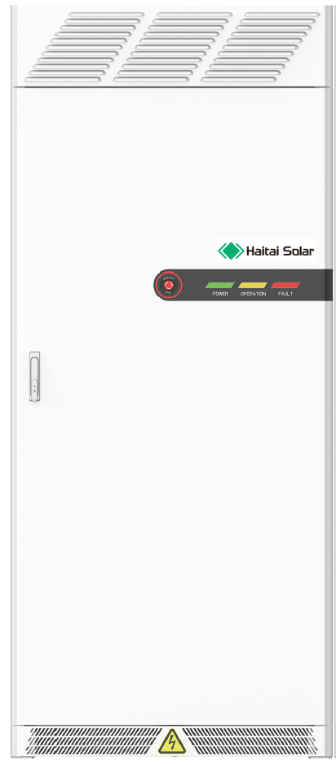
Haitai - Haixin
PCS: 100kW/110kW/125kW
Energy storage battery: 215kWh/ 233kWh/256kWh/372kWh
Industrial and commercial energy storage system
Product Introduction
Haitai digital energy industry & commerce energy storage system is integrated with liquid-cooled battery PACK, high-accuracy BMS (battery management system), intelligent EMS (energy management system), PCS and fire prevention system, etc.
Flexible application in different scenarios based on modular design.
The system can improve the energy quality of power grid, such as voltage deviation, 3-phase imbalance and harmonic wave.
Fitted with functions such as load tracking, standby power supply and peak regulation
The system can help industry & commerce owners reduce the electricity expense, increase the green electricity consumption, and maintain the safe and stable running of system.
Main advantages
Efficient liquid cooling technology, cell temperature difference <3℃
Intelligent monitoring system, integrating BMS and EMS intelligent safety system
All-in-one, easy transport, plug and play
Built-in independent firefighting system
Application scenarios
*Base station
5G communication base station
Backup cell, charging at high battery level or discharging at low battery level
*Renewable energy power generation
Peak load and frequency regulation
Smooth the intermittent energy sources
Increase the new energy consumption
*Power transmission and distribution
Auxiliary services
Delay the demand for capacity expansion of grid
*Island off-grid energy storage
Microgrid
Energy storage in area without electricity
*Industrial and domestic electricity
Peak-load shifting
Level loads and restrain demands
Improve power supply safety
and quality of electric energy

Slide 15
Technical Parameters of Industrial and Commercial Energy Storage
AC side (on-grid)
Application scenarios | Peak-load shifting, energy time shifting
Rated power | 125kW
Access mode | 400Vac,3P+PE
Max. continuous input current | 180A
Rated grid frequency | 50HZ
Power factor | 0.8CAP~0.8IND
THDI | <3%
DC side
Rated Energy | 256kWh
Cell type | Lithium iron phosphate LFP3.2V 280AH
Cycle count | ≥6600 times (0.5C,25℃, 80%EOL, 90%DOD)
Rated voltage | 915.2V
Voltage range | 686.4V~1043.9V
Charge/discharge efficiency | ≥90%
Charging/ discharging current | 128A(0.5C)

Slide 16
Technical Parameters of Industrial and Commercial Energy Storage
Basic parameters
AC/DC switch time | ≤10ms
Protection function | Over/under voltage, over current, high/low temperature, high/low SOC, insulation detection and short-circuit protection
Operating Temperature | －30℃~+50℃(>45℃ derated)
Cooling method | Air cooling (PCS), liquid cooling (cell)
Height above sea level, max. | 2000m
Firefighting Method | Aerosol + Perfluoro (optional) fire extinguishing agent
Max. conversion efficiency | 92 (excluding auxiliary power consumption)
Protection grade | IP55 (battery pack IP67)
Noise | ＜70dB@25℃
Communication | RS485, CAN, Ethernet, ModbusTCP/RTU
Dimensions (W*D*H) mm | 1030x1320x2480mm
Weight | 2700 kg

Slide 17
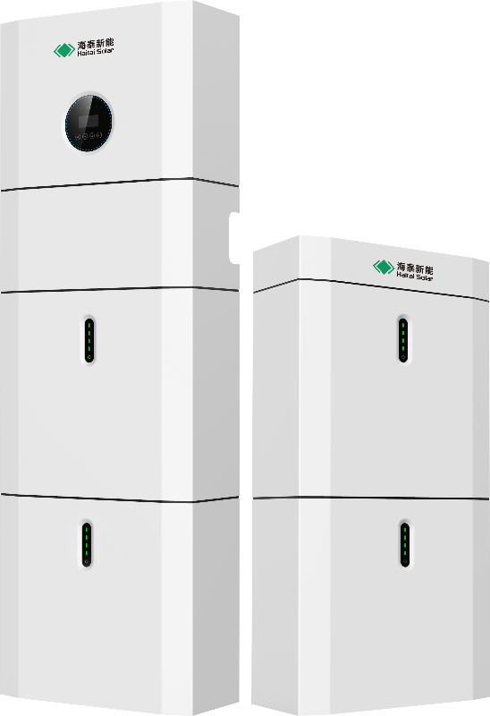
3.3 Display Drawing of Household Energy Storage Effects

Slide 18
3.3.1 Features of Household Energy Storage System
Safe
Reliable
Economic
Efficient
Flexible
Convenient
Digital
Intelligent
LFP (LiFePO₄) battery, 10000 cycles, safe and reliable.
3-stage safety design (module, pack, system).
IP65 protection grade, outdoor installation, far from living room
Low-cost electricity generated by PV power generation can satisfy the household electrical loads.
Reduce water and electricity expense based on peak shift function
Modular design, easy increase or decrease of modules
Plug and play, quick installation in 30 minutes by one operator
Save space, occupied area is 0.15m² only
Monitor system running though global cloud platform and mobile App.
Clear display of system working status

Slide 19
3.3.2 Technical Parameters of Household Energy Storage
Battery specification | PACK5.1 | PACK10.2
Battery terminal parameters
Electric quantity | 5.12kWh | 10.24kWh
Battery type | LFP(LiFePO4)
Depth of discharge (DoD) | 90%
Rated voltage | 51.2V
Operating Voltage Range | 44.8~56.5Vdc
Operating Parameters
Max. charging current | 50A(0.5C) | 100A(0.5C)
Max. discharging current | 80A(0.8C) | 100A(0.5C)
Operating temperature range | -10℃~+50℃
Storage range | -20℃~+50℃
Humidity | 0% ~90%

Slide 20
3.3.3 Technical Parameters of Household Energy Storage
BMS
Module connection | Parallel connection of 4 batteries at most
Monitoring parameters | System voltage, current, battery voltage, battery temperature, PACK temperature measurement
Communication | CAN, RS-485
Cooling method | Forced Wind Cooling
General parameters
Weight (Kg) | 58 | 116
Dimensions (W×H×D)mm | 540*530*240 | 540*1020*240
Protection grade | IP65
Quality guarantee | 5-year product warranty, 10-year performance warranty
Certification
Safe (battery) | IEC 62619, UL 1973, UN38.3

Slide 21
3.3.4 Technical Parameters of Household Energy Storage
Product Types | 3680D-M1 | 5000D-M1 | 6000D-M1
PV side
Max. PV voltage | 580Vd.c.
Rated voltage | 400Vd.c.
MPPT voltage range | 80~550Vd.c.
MPPT range (full-load) | 165~520Vd.c. | 210~520Vd.c. | 250~520Vd.c.
MPPT tracker/character string | 2
Max. continuous PV input current | 15Ad.c.×2
Isc PV | 18Ad.c.×2
Max. feedback current | 0Ad.c.
Max. continuous PV input power | 4800W | 6500W | 7500W
Battery side
Battery type | Lithium iron phosphate (LFP)
Voltage range | 40~60Vd.c.
Rated voltage | 48Vd.c.
Max. charging/discharging current | 50Ad.c./80Ad.c. | 80Ad.c./100Ad.c.
Max. charging/discharging power | 3000W/4000W | 4600W/5000W

Slide 22
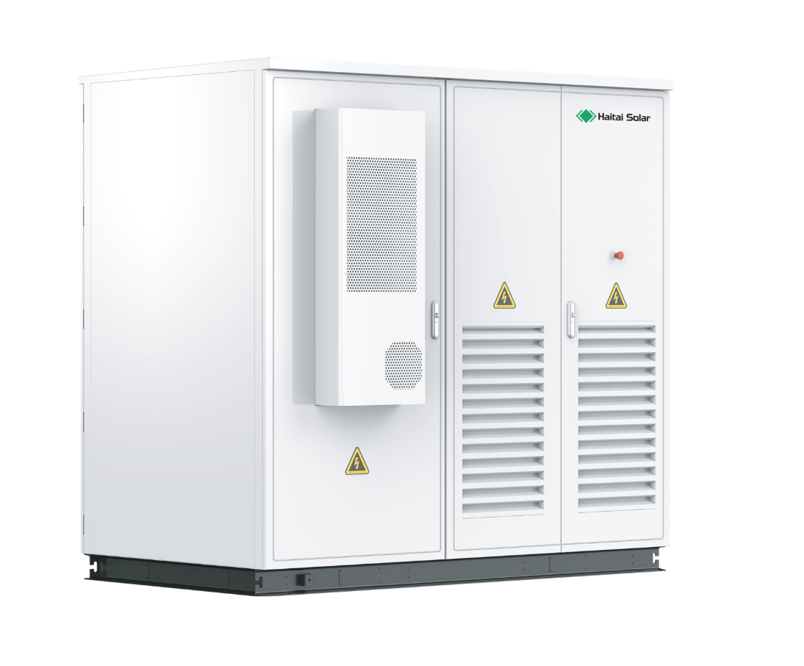
Outdoor Cabinet Type Integrated Optical Storage System
Product Highlights
Support flexible expansion of PV power generation capacity;
Support access of load, battery, grid, diesel generator and PV at the same time;
Integrated with EMS functions, to ensure high safety and stability;
Support prediction of battery capacity and discharging time;
Built-in isolated transformer, with strong adaption to loads.

Slide 23
Outdoor Cabinet Type Integrated Optical Storage System
Model | ESSA0030B-0055 | HTDESS0050B-0055 | HTDESS0050B-0100 | HTDESS0100B-0215
Rated power (kW) | 30 | 50 | 50 | 100
Rated voltage (V) | 400
Rated current (A) | 43 | 72 | 72 | 144
Voltage range (V) | 320V-460V
Rated frequency | 50/60Hz
Frequency range | 45-55/55-65Hz
THDi (on-grid) | <3%
THDu (off-grid) | ≤1% linear, ≤5% nonlinear
Power factor | 1 (0.8 lead ~ 0.8 lag)
Overload capacity | 110% long-term
AC output | 3W+N+PE
Isolation transformer | 100/400 | 200/400 | 200/400 | 270/400
On-grid/off-grid switching | Supported

Slide 24
Outdoor Cabinet Type Integrated Optical Storage System
Model | ESSA0030B-0055 | HTDESS0050B-0055 | HTDESS0050B-0100 | HTDESS0100B-0215
PV
Max. PV input voltage (V) | 1000
Max. PV power (kW) | 60/120 | 60/120 | 60/120 | 120/180/240
MPTT working voltage range (V) | 250-850
MPPT full load voltage range (V) | 450-850
Voltage increase/decrease mode | Supported

Slide 25
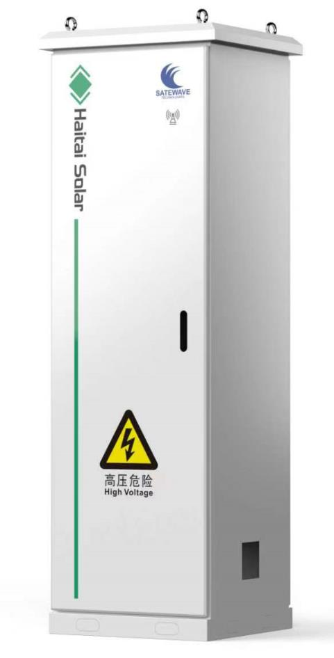
Communication power supply system
The new energy mixed power supply system of communication base station can be configured with different power supply system devices according to the requirements of base station
PV MPPT controller and mains supply rectifier are provided with modular installation, supported PV ranges from 5kW to 30kW; mains supply rectifier supports 5-15kW capacity expansion.
It can manage multiple energies at the same, such as solar energy, wind energy, mains supply, fuel oil generator and battery.
The product supports multiple protections such as overvoltage, overcurrent, overheat, undervoltage and short-circuit.
Integrated with battery management function, with protection against reverse connection, overcharging and over-discharging of battery.
Support RS232, RS485, CAN and other communication interfaces.
Outdoor IP54 protection grade, multiple safety controls and lightning prevention design, adaptive to severe environment such as high altitude and ultra-low temperature.

Slide 26
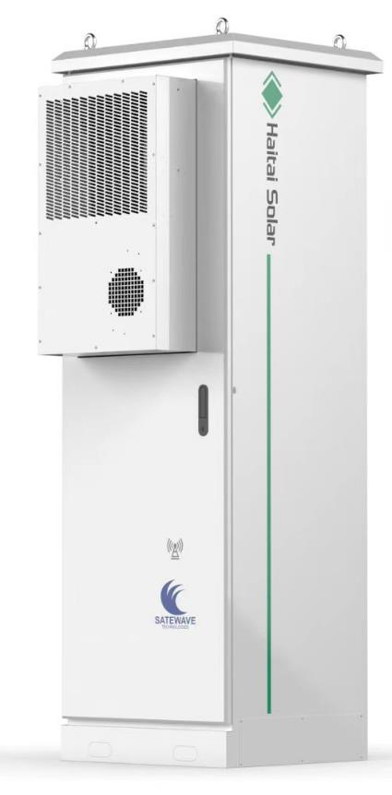
Communication power supply system
Parameters of control cabinet
Input voltage of PV controller | 60Vdc~150Vdc
Output voltage and current of PV controller | 48Vdc/50A
Install quantity of PV controller | 3-10PCS
Input voltage of rectifier module | 90Vac to 300Vac
Output voltage and current of rectifier module | 48Vdc/50A
Install quantity of rectifier module | 3-6PCS
Protection grade | IP54
Cooling method | Natural air cooling
Dimensions | 600*600*2000
Power cabinet parameters
Battery module capacity | 51.2V100AH
Battery module dimensions | 3U
Cell type | Lithium iron phosphate
Parallel operation quantity | <10 PCS
Cooling method | AC

Slide 27
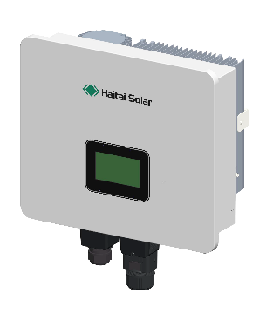
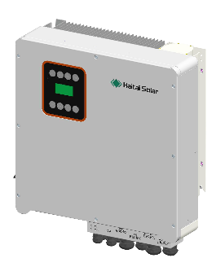
Residential Energy Storage Inverter
Product Introduction
3-6kW HTDESS S 3.0K-6.0K G2
Single-phase mixed inverter
6-15kW HTDESS T6.0K -15k G1
3-phase mixed inverter
Single-phase mixed inverter 3-8kW, 3-phase mixed inverter 6-15kW, support parallel connection of multiple units, support 5-40kWh battery, input end supports 1.5 times of component capacity expansion, in order to satisfy the demands of customers to the maximum;
PV string 16A, support access of 182/210 high-power PV components;
Zero-time switching between on-grid/off-grid of grid and battery, to guarantee the power consumption.
Main advantages
Friendly and flexible
·Support parallel connection of multiple machines;
·Compatible with multiple batteries, such as lead acid and lithium ion batteries;
Safe and reliable
·Compatible with anti-reverse flow function;
·Protection against battery reverse connection;
Intelligent Management
·Household smart energy management terminal
·Power dispatching and response management node at demand side;
·Management node of distributed virtual power station;
Economical and efficient
·Max. efficiency ≥97. 5%;
·Small volume, wide applications, save the installation space;

Slide 28
Technical Parameters of Household Single-phase Energy Storage Inverter
Model parameters | HTDESS S3.0K G2 | HTDESS S4.0K G2 | HTDESS S5.0K G2 | HTDESS S6.0K G2
DC input
Max. input power (kW) | 4.5 | 6 | 7.5 | 9
Starting voltage (V) | 100
Max. PV voltage (V) | 550
MPPT voltage range/rated voltage (V) | 80~500/360
Max. input current (A) | 16
Number of MPPT circuits | 2
Parallel output
Rated power (kW) | 3 | 4 | 5 | 6
Max. output power (kVA) | 3.3 | 4.4 | 5 | 6.6
Rated voltage/range (V) | 230 /176~270
Frequency (Hz) | 50 /60
Power factor | 0.8 lagging-0.8 leading
Harmonic current | <3%
Grid connection type | L+N+PE

Slide 29
Technical Parameters of Household Single-phase Energy Storage Inverter
Model parameters | HTDESS S3.0K G2 | HTDESS S4.0K G2 | HTDESS S5.0K G2 | HTDESS S6.0K G2
Cell
Rated voltage/range (V) | 51.2/40~58
Max. charging voltage (V) | 58
Max. charging/discharging current (A) | 60/60 | 80/80 | 100/100 | 120/120
Communication Method | CAN
Battery type | Lithium battery/lead acid battery
Off-grid output
Rated power (kW) | 3 | 4 | 5 | 6
Rated voltage (V) | 220/230V
Max. current (A) | 14.3 | 19.1 | 21.7 | 28.7
Rated frequency (Hz) | 50/60
Switching time (ms) | <10ms
Harmonic voltage | <2%
Overload capacity | 110%,60S/120%,30S/150%.10S

Slide 30
Technical Parameters of Household Single-phase Energy Storage Inverter
Model parameters | HTDESS S3.0K G2 | HTDESS S4.0K G2 | HTDESS S5.0K G2 | HTDESS S6.0K G2
General data
Charge/discharge efficiency | 96%
Max. efficiency | 98%
European efficiency | 97%
MPPT efficiency | 99.90%
Protection grade | IP65
Noise (dB) | <35
Operating temperature (℃) | -25~60
Cooling method | Natural cooling
RA Temp. | 0 ~95% (no condensation)
Altitude | 4,000m(>2,000 derating)
Dimensions W × D × H(mm) | 451×200×474
Weight (kg) | 18
Isolation mode | No isolation transformer
Self-consuming (W) | <3
Display and communication
Display | LCD LED
Interface:RS485/Wifi/4G/CAN/DRM | RS485/Wifi/4G/CAN/DRM Opt

Slide 31
Technical Parameters of Household 3-phase Energy Storage Inverter
Model parameters | HTDESS T6.0K G1 | HTDESS T8.0K G1 | HTDESS S10K G1 | HTDESS T12K G1 | HTDESS T15K G1
DC input
Max. input power (kW) | 6 | 8 | 10 | 12 | 15
Starting voltage (V) | 200
Max. PV voltage (V) | 1000
MPPT voltage range/rated voltage (V) | 180~850/600
Max. input current (A) | 16
Number of MPPT circuits | 2
Parallel output
Rated power (kW) | 6 | 8 | 10 | 12 | 15
Max. output power (kVA) | 6.6 | 8.8 | 11 | 13.2 | 16.5
Rated voltage/range (V) | 400 /340~460
Frequency (Hz) | 50 /60
Power factor | 0.8 lagging-0.8 leading
Harmonic current | <3%
Grid connection type | 3W+N+PE

Slide 32
Technical Parameters of Household 3-phase Energy Storage Inverter
Model parameters | HTDESS T6.0K G1 | HTDESS T8.0K G1 | HTDESS S10K G1 | HTDESS T12K G1 | HTDESS T15K G1
Cell
Rated voltage/range (V) | 360/125-550
Max. charging voltage (V) | 600
Max. charging/discharging current (A) | 50
Communication Method | CAN
Battery type | Lithium battery/lead acid battery
Off-grid output
Rated power (kW) | 6 | 8 | 10 | 12 | 15
Rated voltage (V) | 380/400V
Max. current (A) | 9.5 | 12.7 | 15.9 | 21.7 | 28.7
Rated frequency (Hz) | 50/60
Switching time (ms) | <10ms
Harmonic voltage | <2%
Overload capacity | 110%, 60S/120%, 30S/150%.

Slide 33
Technical Parameters of Household 3-phase Energy Storage Inverter
Model parameters | HTDESS T6.0K G1 | HTDESS T8.0K G1 | HTDESS S10K G1 | HTDESS T12K G1 | HTDESS T15K G1
General data
Charge/discharge efficiency | 98% | 97.50% | 97.50% | 97.50% | 97.80%
Max. efficiency | 98% | 97.90% | 98.20% | 98.20% | 98.50%
European efficiency | 97% | 97.50% | 97.50% | 97.60% | 97.80%
MPPT efficiency | 99.90%
Protection grade | IP65
Noise (dB) | <35
Operating temperature (℃) | -25~60
Cooling method | Natural cooling
RA Temp. | 0 ~95% (no condensation)
Altitude | 4,000m(>2,000 derating)
Dimensions W × D × H(mm) | 596*566*220
Weight (kg) | 30 | 31 | 31 | 33 | 34
Isolation mode | No isolation transformer
Self-consuming (W) | <3
Display and communication
Display | LCD LED
Interface:RS485/Wifi/4G/CAN/DRM | RS485/Wifi/4G/CAN/DRM Opt

Slide 34
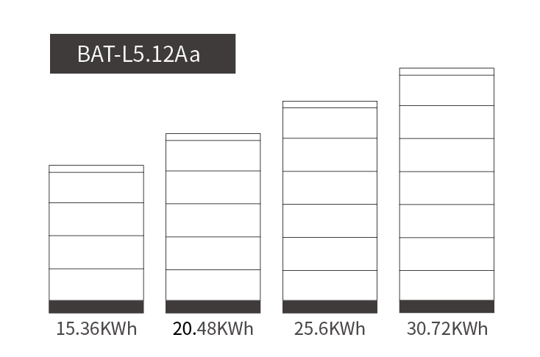
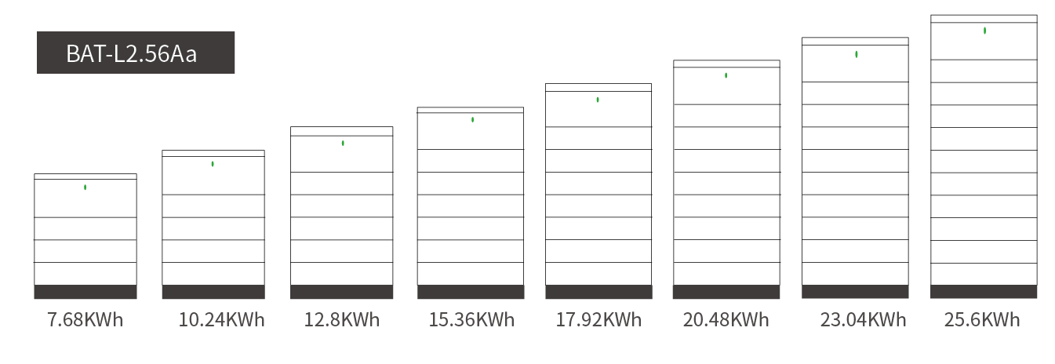
Residential Energy Storage Battery Pack
HTDESS 2.56kWh 51.2V/50AH module
HTDESS 5.12kWh 51.2V100AH module
Product Introduction
The two modular batteries of 2.56kWh and 5.12kWh have small and lightweight single modules. The battery combination can be customized easily through simple installation steps, to satisfy your demands of energy storage. The entire system can be intelligent and flexible through reliable BMS system and high-performance balancing technology, to provide you a discharging platform of higher stability.
Main advantages
•Higher conversion efficiency
•Reduce reliance on grid
•Better adaption to large-load applications
•Higher flexibility
•Lower cost, larger system
•Faster charging and discharging
•Energy saving

Slide 35
Technical Parameters of Low-voltage Stacked Battery Pack
Model | HTDESS LP 2.56 D1 | HTDESS LP 5.12 D1
Rated voltage (Vdc) | 51.2 | 51.2
Rated capacity (Wh) | 2560 | 5120
Working voltage range (Vdc) | 44.8-56.16 | 44.8-56.16
Charging voltage (Vdc) | 58.4 | 58.4
Rated charging/discharging current (A) | 25 | 50
Max. charging/discharging current (A) | 50 | 100
Peak current (A) | 100@3sec | 200@3sec
Number of units in parallel | <10pcs | <6pcs
Cycle life | 6000@80% DOD,25℃/0.5C
Structure
Dimensions (mm) | 600*210*180 | 600*210*300
Weight (kg) | 29 | 50.5
Protection grade | IP65
Type of mounting | Stacking type
Work environment
Charging temperature ℃ | 0~55
Discharging temperature ℃ | -20~60
Latitude | <2500
Relative temperature (RH) | 5~95% (no condensation)
Communication
communication interface | 485 CAN
Display | LED indicator shows the remaining power

Slide 36
Technical Parameters of High-voltage Stacked Battery Pack
Model | HTDESS HP 2.56 D1 | HTDESS HP 5.12 D1
Rated voltage (Vdc) | 51.2 | 51.2
Rated capacity (Wh) | 2560 | 5120
Working voltage range (Vdc) | 129.6-516.6 | 129.6-350.4
Charging voltage (Vdc) | 58.4 | 58.4
Rated charging/discharging current (A) | 25 | 50
Max. charging/discharging current (A) | 50 | 100
Peak current (A) | 100@3sec | 200@3sec
Number of units in parallel | <10pcs | <6pcs
Cycle life | 6000@80% DOD,25℃/0.5C
Structure
High-voltage box dimensions (mm)/weight (kg) | 600*210*250/14 | 610*225*250/15
Battery cabinet dimensions (mm)/weight (kg) | 600*210*160/27 | 610*225*250/52
Pedestal (mm)/weight (kg) | 610*225*90/5 | 610*225*90/5.5
Top cover T (mm)/weight (kg) | 600*210*50/2.5 | 610*225*50/3
Protection grade | IP65
Type of mounting | Stacking type
Work environment
Charging temperature ℃ | 0~55
Discharging temperature ℃ | -20~60
Latitude M | <2500
Relative temperature (RH) | 5~95%(W/O condensing)
Communication
communication interface | 485 CAN
Display | LED indicator shows the remaining power

Slide 37
Thank you
THANK YOU FOR WATCHING
Tangshan Haitai Digital Energy Technology Co., Ltd.

